Slide 1
"Create A 2-minute Presentation On Bangladesh's Role In South Asia's Geopolitics, Covering Security,
SlideMake.com

Slide 2
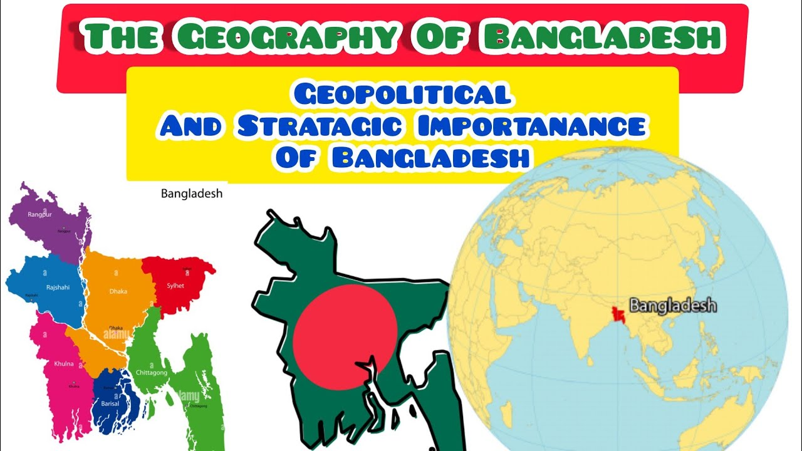
Introduction to Bangladesh's Geopolitical Importance
Bangladesh is strategically located between India and Myanmar, making it a vital player in South Asia.
The country has a population of over 160 million, contributing to its economic and geopolitical significance in the region.
Its emerging economy and democratic governance model position Bangladesh as a key influencer in regional politics.
Notes:
Image source: https://www.youtube.com/watch?v=hjCLO-DYgbA

Slide 3
Security Dynamics in South Asia
The South Asian region faces numerous security challenges, including terrorism and border disputes.
Bangladesh plays a crucial role in counter-terrorism efforts and fostering regional stability.
Its geographical location allows it to serve as a buffer state amidst tensions between India and Pakistan.
Notes:
Image source: https://www.researchgate.net/publication/341787518_Analysis_the_Main_Characteristics_and_Dynamics_of_Sub-Regional_Security_Complex_of_South_Asia_IOSR-JHSS

Slide 4
Relations with India
Bangladesh maintains a complex yet cooperative relationship with India, focusing on trade and security collaboration.
The two nations have joint initiatives to combat cross-border terrorism and human trafficking.
India's support for Bangladesh's development projects further solidifies their partnership in regional security.
Notes:
Image source: https://www.mapsofindia.com/my-india/government/india-bangladesh-relations

Slide 5
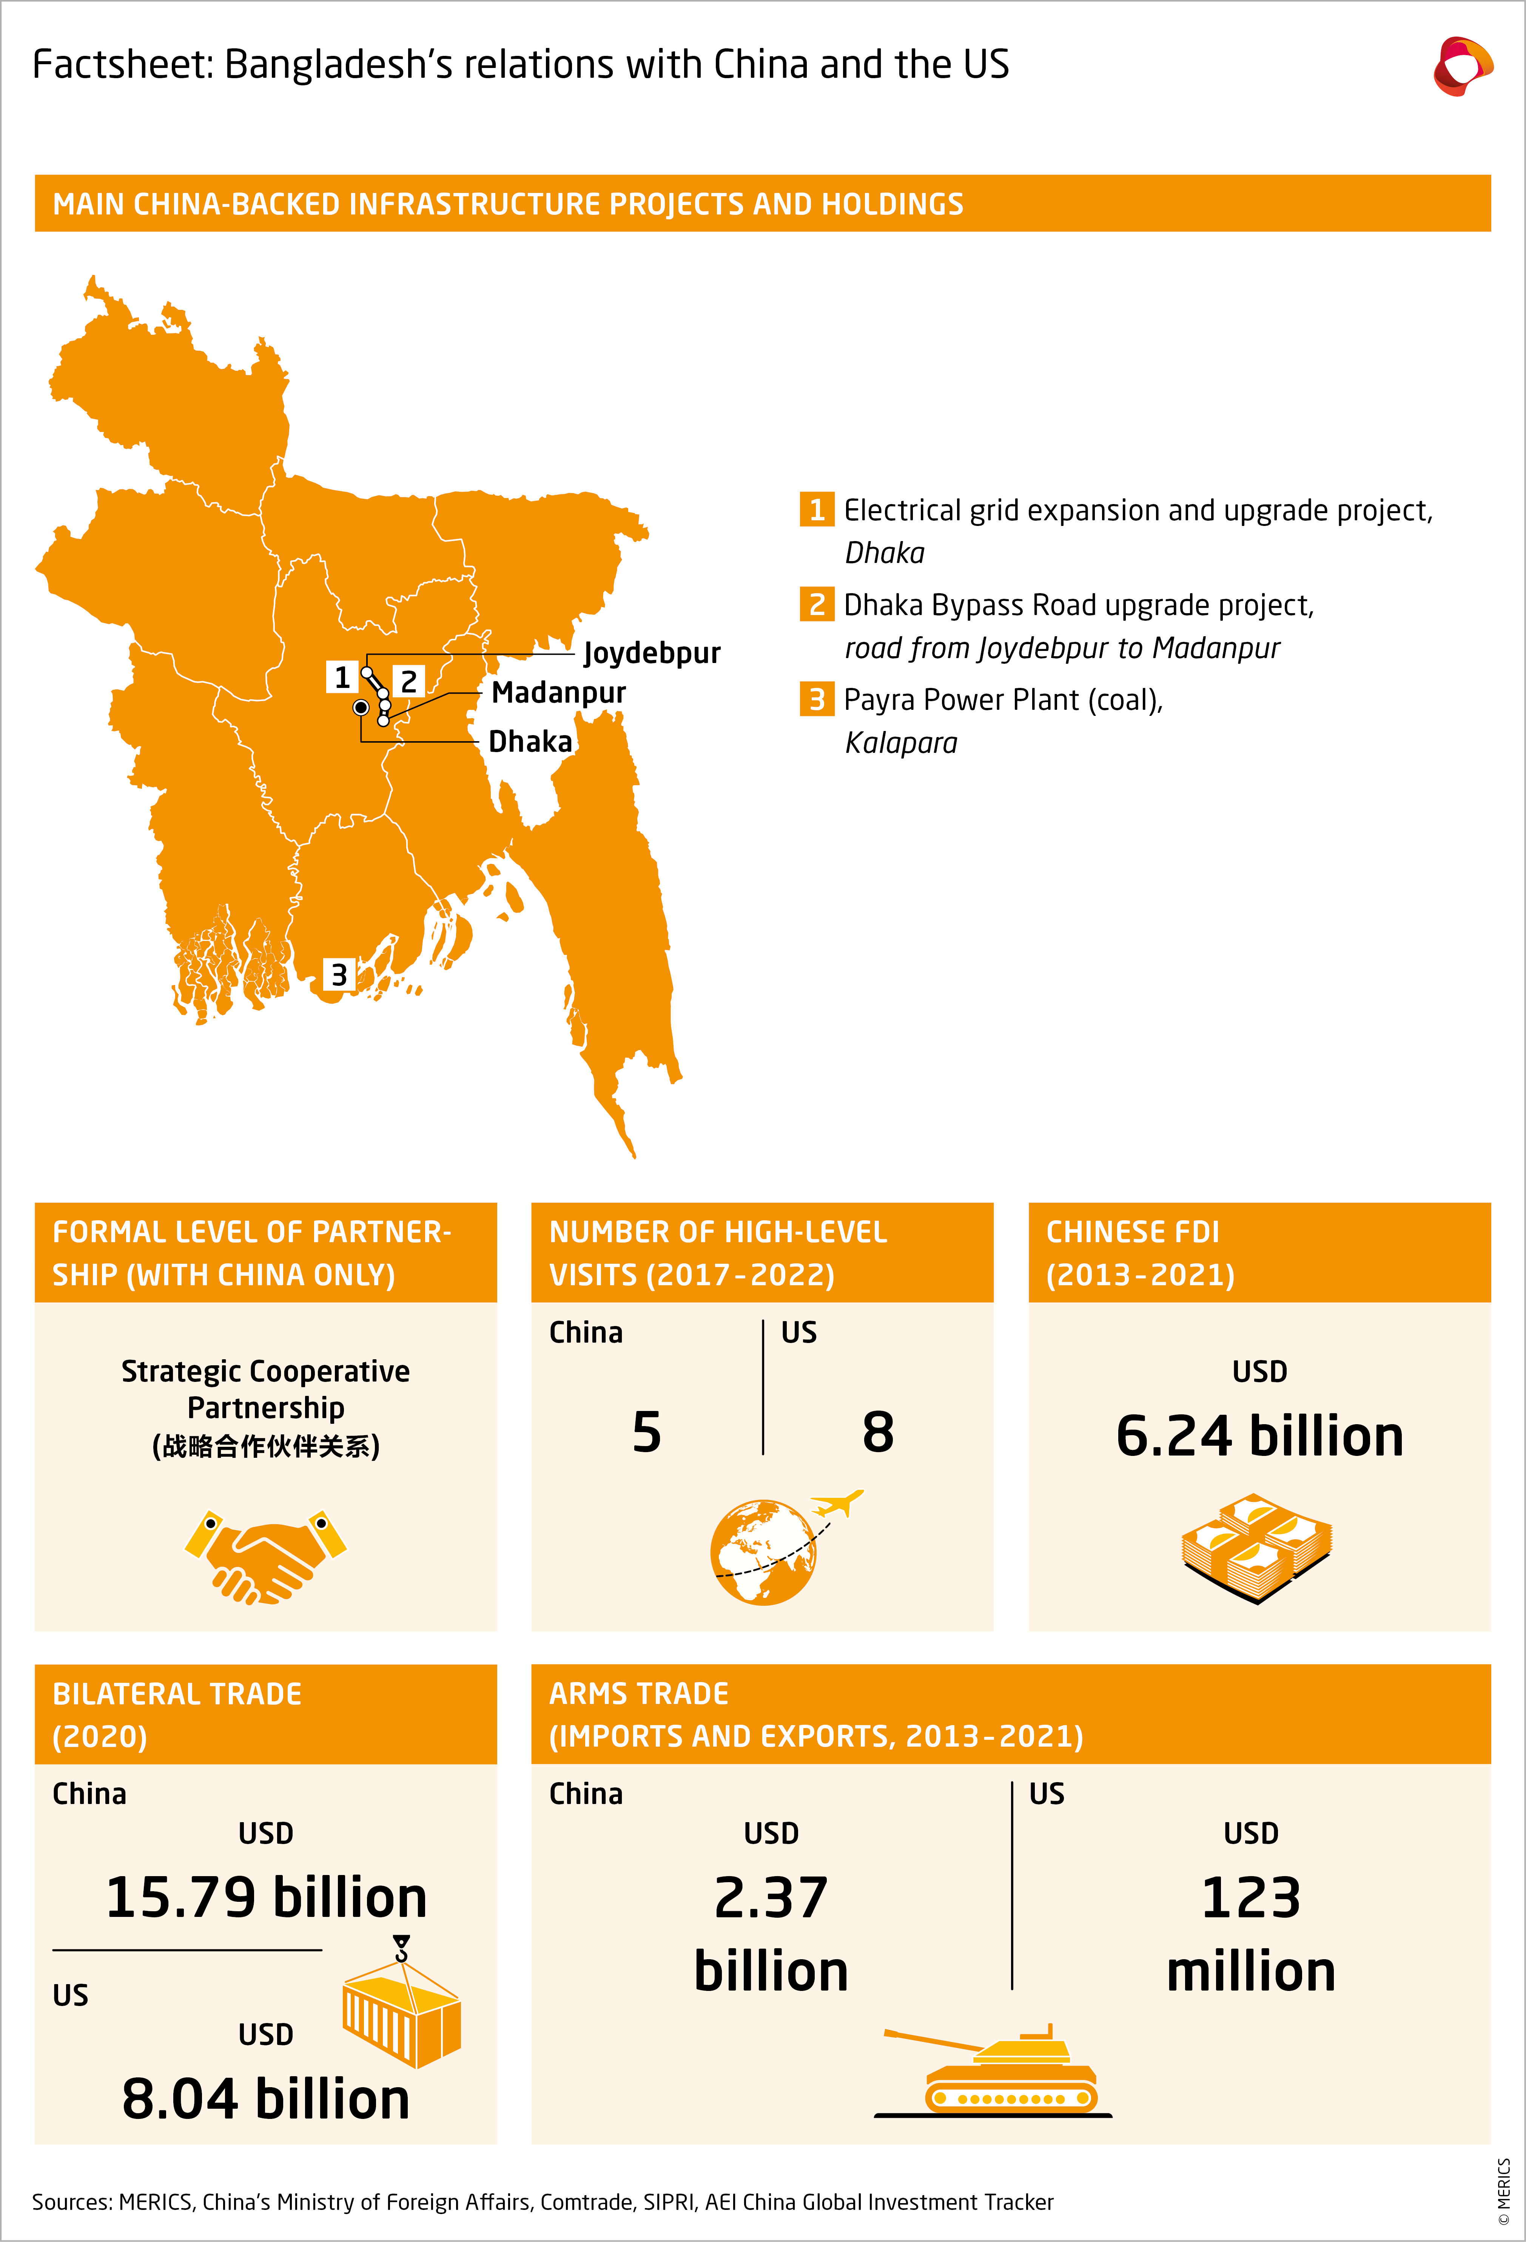
Ties with China
Bangladesh's growing ties with China introduce a new dimension to South Asian geopolitics.
The China-Bangladesh Economic Corridor is a significant investment that enhances infrastructure and economic growth.
This relationship complicates Bangladesh's security dynamics, as it balances between Indian and Chinese influences.
Notes:
Image source: https://merics.org/en/china-bangladesh-relations-three-way-balance-between-china-india-and-us

Slide 6
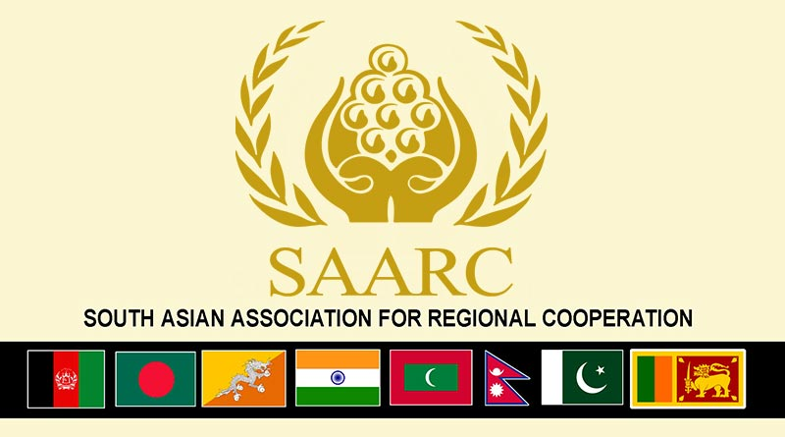
Regional Organizations and Alliances
Bangladesh is an active member of the South Asian Association for Regional Cooperation (SAARC) and other regional forums.
Through these platforms, Bangladesh advocates for collaborative approaches to security and development.
Its leadership role in initiatives like the Bay of Bengal Initiative for Multi-Sectoral Technical and Economic Cooperation (BIMSTEC) enhances regional connectivity and security.
Notes:
Image source: https://currentaffairs.adda247.com/saarc/

Slide 7
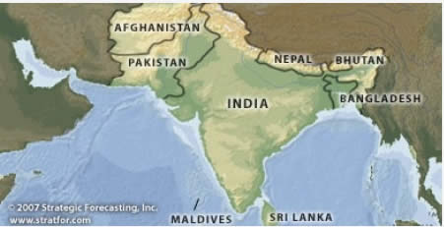
Future Prospects and Challenges
Bangladesh's role in South Asia's geopolitics will likely grow as it navigates complex regional dynamics.
Challenges such as climate change, economic disparity, and terrorism require cooperative security strategies.
The country's ability to maintain balanced relations with major powers will shape its future influence in the region.
Notes:
Image source: http://thedailyjournalist.com/the-strategist/south-asia-geopolitics-strategic-stability-instability-and-the-collective-conflict-management/

Slide 8
References
"Bangladesh and Regional Security Dynamics"
Journal of South Asian Studies, 2023.
"Geopolitical Implications of China-Bangladesh Relations"

